Slide 1
The Msharp Compiler
Steve “desire2020” Lu

Slide 2
What’s interesting?
Flexible AST
Thx to the hand-made parser :)
Great library generated by gcc
No additional library is dependent.
All the functions are hand-made.
Some interesting optimization.
Shares the same IR with the Pen project and the CAP project.
Interpretable IR!

Slide 3
What’s ugly?
Code style.
A total disaster.
Memory management.
Had to handle many disgusting cases to prevent memory leaking because there is no GC in the C++ programming language.
This almost killed me.
Register allocation.
A stupid greedy algorithm that uses registers as a cache of memory of the lower hierarchy.
Slow and ugly.

Slide 4
Optimization 1: function inlining
Only support functions that are embedded with a single return statement.

Slide 5
Optimization 2: linear expression compression
A = x + x + x + t + t + t + t + t + t + 7 + 5 + 1
=> A = x * 3 + t * 6 + 13
Only support monomial.
The constant folding optimization is included as part of this optimization.

Slide 6
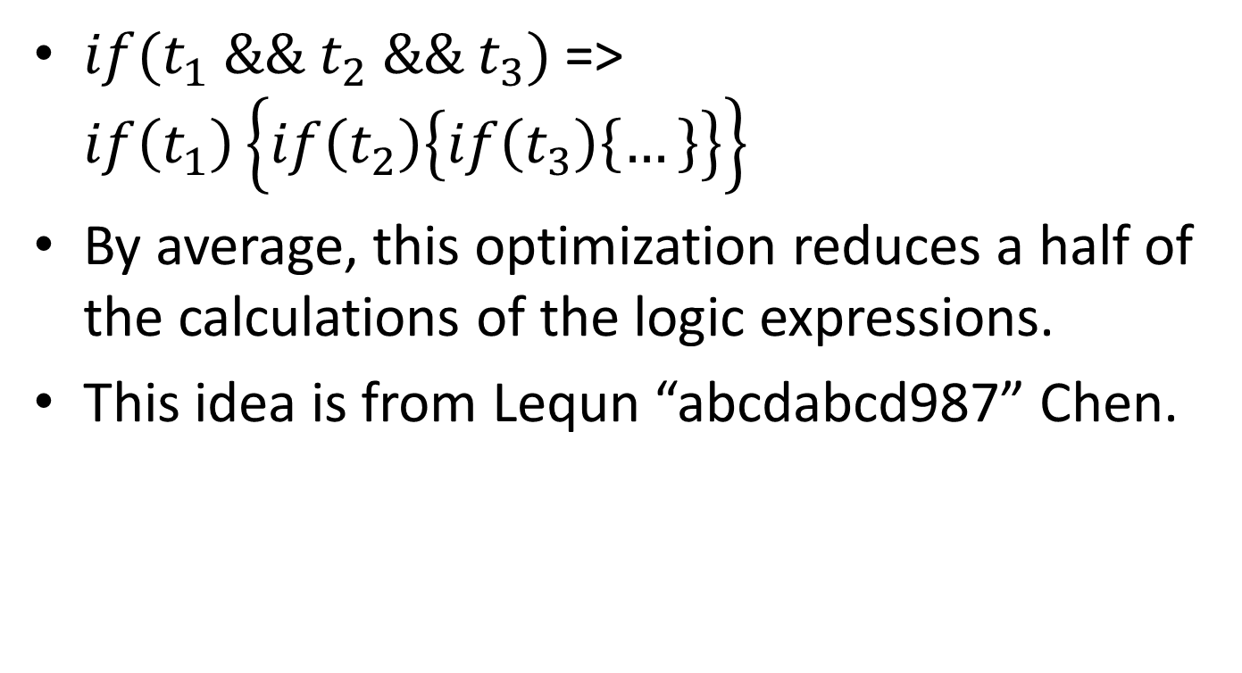
Optimization 3 : If phrase enlarge
$if(t_{1} \&\& t_{2} \&\& t_{3})$ => $if\left(t_{1}\right)\left\{if\left(t_{2}\right)\left\{if\left(t_{3}\right)\left\{…\right\}\right\}\right\}$
By average, this optimization reduces a half of the calculations of the logic expressions.
This idea is from Lequn “abcdabcd987” Chen.

Slide 7

Optimization 4: Loop truncation
$for(i=0;i≤2000; ++i)$
$\{$
$if\left(k<0\right)\{…\}$
$\}$
=>
$if\left(k<0\right)$
$\{$
$for(i=0;i≤2000; ++i)$
$\{…\}$
$\}$
This idea is from Tiancheng Xie.

Slide 8
Optimization 5:AST-level dead code elimination
Empty Loop
Unused initialization

Slide 9
Optimization 6: Abstract interpretation
AST Level:
Used to judge whether a function is a pure function (with no side effect and can be computed if given constexpr parameters).
IR Level: (not fully implemented)
Fold the whole program and directly output the answer if possible.
Liveness analysis.
Register allocation.

Slide 10
Testcase 1: rvalue test
Is the member of an rvalue object rvalue?
C++ : yes
JAVA/C# : no
M* : NO! (Verified by Lequn Chen).

Slide 11
Testcase 2:Fibonacci
Tail recurrence optimization.
Level 0 : use jmp instead of call to start recurrence.
Complexity doesn’t change.
Level 1 : use loop to replace the optimization.
Complexity is reduced.
Constexpr folding.
A pure function’s return value can be computed at compile time if given constexpr parameters.

